Slide 1


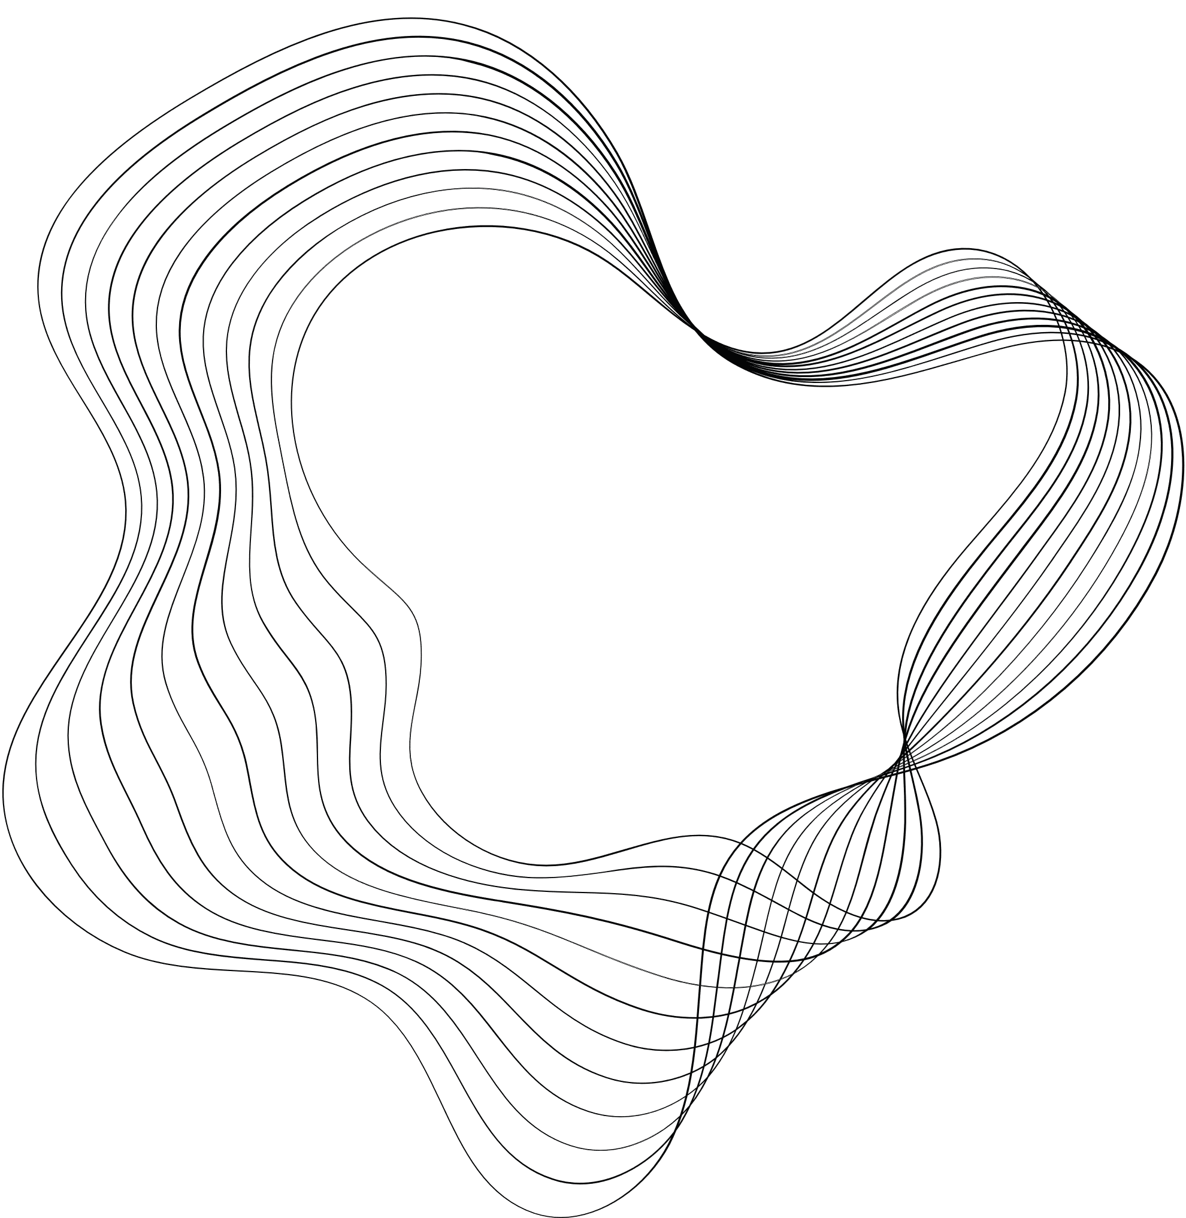
Presented by: Joseph Ashraf Essmate Rana Osama Mohammed Nourhan Hanna Louiz
Machine learning project
Stellar Classification
Machine Learning CS361

Slide 2

Stellar Classification
Problem Definition and Importance Classification of celestial objects (stars, galaxies, quasars) is crucial in astronomy for understanding the universe's structure and evolution. This project aims to develop an AI system to automate this classification using a dataset of astronomical observations, improving efficiency and accuracy.

Slide 3
Methodology
Algorithms And Their Accuracy
Selected Algorithm

Slide 4
Methodology
In this project, several machine learning algorithms were considered for classifying celestial objects into stars, galaxies, or quasars. The main algorithms analyzed include k-Nearest Neighbors (k-NN), Naive Bayes, Logistic Regression, Decision Tree, and Random Forest. Each algorithm has distinct approaches and steps for classification.
By leveraging the robustness and ensemble nature of Random Forests, the project achieves high accuracy in classifying celestial objects, ensuring that the system can handle the complexities and variances in astronomical data efficiently.

Slide 5
Algorithms And Their Accuracy
Random Forest : its accuracy is 97%
Decision Tree : its accuracy is 95%
Logistic Regression : its accuracy is 77%
K-NN : its accuracy is 74%
Naïve Bayes : its accuracy is 66%

Slide 6
Selected Algorithm
After thorough analysis and comparison, the Random Forest algorithm has been selected as the primary model to solve the stellar classification problem. Random Forests offer several advantages for this task:
Robustness
Interpretability
Handling High-Dimensional Data
Efficiency

Slide 7
Experimental Simulation
Preprocessing
Splitting The Data
Model Training

Slide 8
Preprocessing
-The purpose of the "handle data balance" function is to balance a dataset by reducing the number of rows for a specific class. In our case, the function focuses on the class labeled ’GALAXY’ which is our target.
Before
After

Slide 9
Preprocessing
-The purpose of the "handle non-numerical values" function is to convert non-numerical categorical values in a dataset into numerical values, making them suitable for use in machine learning algorithms, such as K-Nearest Neighbors (KNN) and Logistic Regression, which typically require numerical input. In our case, the target column "class" contains string values.

Slide 10
Preprocessing
-The purpose of the "handle noise values" function is to clean the dataset by addressing noise, specifically by replacing any negative values with NAN.
-Then we used "handle missing values" function is to handle missing values within the dataset by filling them with the mean value of each respective column

Slide 11
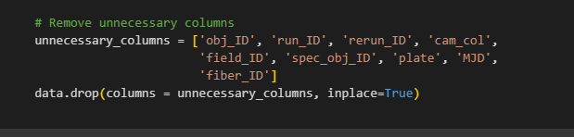
Preprocessing
The aim of these lines of code is to call the data cleaning functions that were expressed above and remove unnecessary columns from the dataset. This step is crucial for improving computational efficiency, reducing model complexity, and mitigating the risk of overfitting.

Slide 12
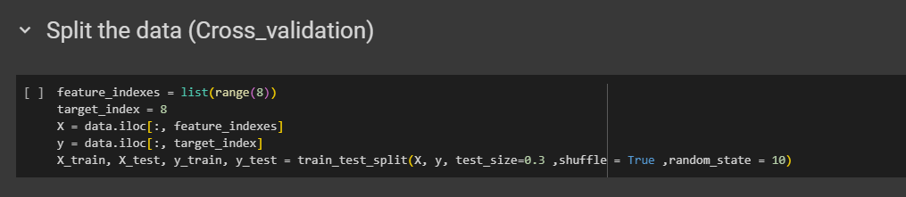
Splitting The Data
Here we prepare our dataset by partitioning it into features (X) and the target variable (y) variable. The testing data is chosen to be 30% of the total dataset, leaving 70% for training purposes.

Slide 13
Model Training
We used the Random Forest algorithm to train our dataset, employing a forest of 100 decision trees.

Slide 14
Results & Evaluation
Accuracy And Confusion Matrix
Testing

Slide 15
Accuracy And Confusion Matrix

Slide 16
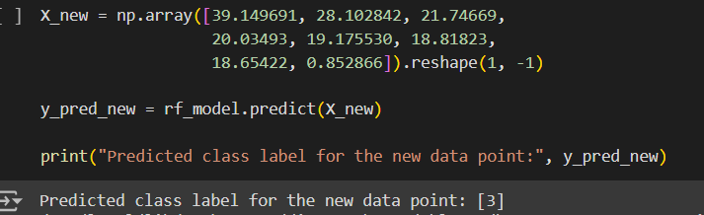
Testing
-These are some tests for new data points.

Slide 17
Thank You

